Slide 1









Gatekeeper
Secure Cybersecurity Job Portal and Management System...
Thishula Nimsara - 105517068
Charith Jayashan - 105976643
Quoc Viet Truong - 105697481
Tasin Bin Mannan - 105959217

Slide 2








Content
Introduction
Project Contributions
What we have learned
Conclusions

Slide 3





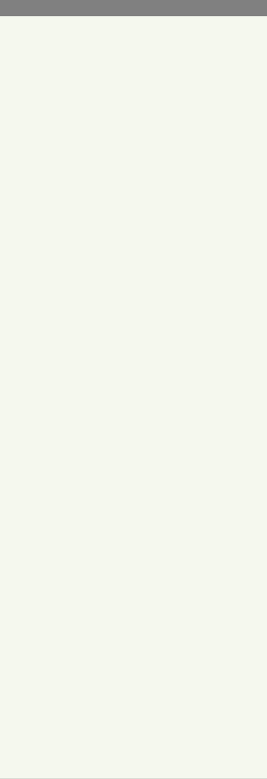

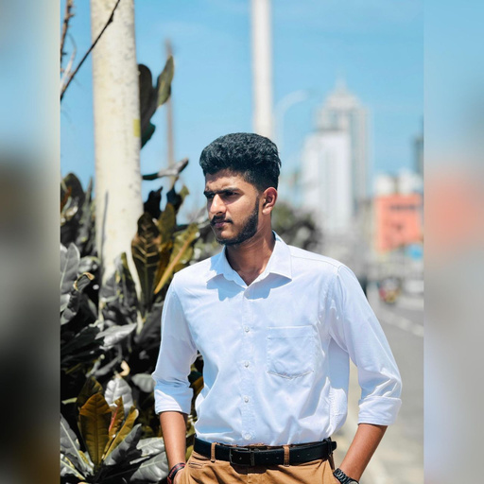
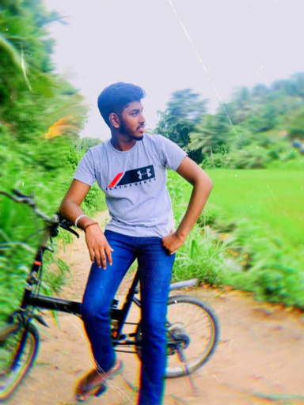






INTRODUCTION
Thishula Nimsara
Charith Jayashan
Quoc Viet Truong
Tasin Bin Mannan

Slide 4





PROJECT CONTRIBUTIONS
1) Thishula Nimsara Punchihewa - Team Leader
Part 1
Created jobs.html with a stylish, unified navigation header for all pages.
Set up our Jira project with complete scrums, epics, and user stories.
Created our GitHub repository and linked all team members.
Selected a suitable background design for the website.
Part 2
Created our gate_keeper database with three tables — eoi, jobs, and users
Uploaded all job data into the jobs table and dynamically displayed them on jobs.php.
Created settings.php to establish the database connection.
Developed sign_up.php to allow users to register before accessing the website.

Slide 5





PROJECT CONTRIBUTIONS
2) Quoc Viet Troung
Part 1
Developed the website’s name and logo design.
Developed index.php, the homepage of our website.
Designed the footer and linked it across all webpages.
Part 2
Created header, footer, and navigation include files, and integrated them across all webpages.
Developed manage.php by following all instructions from Assignment 2.
Created logout.php to log out from all webpages and linked it across the site.
Assisted team member Tasin with his tasks.

Slide 6

PROJECT CONTRIBUTIONS
3) Charith Jayashan-Group Member
Part 1
Created the Apply page (apply.html) by carefully following all the instructions and requirements outlined in the rubric.
Tested navigation headers with the team leader to ensure smooth functionality.
Part 2
Modified the apply.php file according to the Assignment 2 instructions.
Developed process_eoi.php and linked it with apply.php for form processing.
Created login.php specifically for manage.php and linked it with the users table for authentication.
Checked the entire assignment together with the team leader for accuracy and completeness.

Slide 7
PROJECT CONTRIBUTIONS
4) Tasin Bin Mannan
Part 1
Created about.html following all requirements from Project Part 1.
Tested background images for the website together with the team leader.
Part 2
Fixed all errors based on feedback from Assignment 1.
Created the about table with all information from Assignment 1.
Dynamically loaded all information from the about table into about.php.
Assisted team member Viet with developing manage.php.

Slide 8






WHAT WE HAVE LEARNED
Developed teamwork and communication skills by working in a group project environment.
Supported team members with debugging, testing, and validation of webpages.
Understood that effective communication is the key to successful group work.
Improved our debugging and troubleshooting abilities (syntax errors, connection issues, etc.).
Understood the importance of MySQL and how security implementations help protect stored data.
Understood how frontend and backend connect to create a dynamic user experience.
Learned to design and structure webpages using HTML and CSS for layout and styling.
Understood the difference between static and dynamic websites.
Gained experience with sessions and login/logout systems for user management.
Learned to load webpage content dynamically (e.g., about.php, jobs.php) from database tables.

Slide 9




Conclusions
Part 1
In Assignment 1, we developed our GateKeeper website using only HTML and CSS.
All the website content and data were hard-coded (no dynamic functionality yet).
Part 2
In Assignment 2, we created our GateKeeper database consisting of four tables — about, eoi, users, and jobs.
We converted our static website into a dynamic website by connecting it to the database.
The jobs.php and about.php pages now load their information directly from the database.
The users table is integrated with manage.php to handle administrative functions.
We developed a new file called process_eoi.php, which is linked to the eoi table.
When a user submits the apply form, all entered details are sent to process_eoi.php.
Inside this file, the input data is validated, and if all information is correct, it is stored into the eoi table.

Slide 10




THANK YOU!
In a world driven by technology, our website stands as a secure gateway connecting talent with opportunity.

